Slide 1

19CSE212 DSA
Online Food Delivery System
We present a novel system using hybrid data structures of graphs and queues to optimise online food delivery. By bridging the gaps between diverse data structures and maximising their combined advantages, we offer a flexible method of problem-solving.
Samarth P CB.EN.U4CSE21253
MB Ajay Kumar CB.EN.U4CSE21236

Slide 2
Objective and Significance
Objective 🎯
Significance 🌟
The objective of our project is to design and implement a hybrid data structure that combines the strengths of a graph and a queue. This hybrid structure will be utilised to create an efficient online food delivering system.
Hybrid data structures combine multiple data structures to efficiently solve complex problems. They offer versatility in problem-solving by leveraging the strengths of each structure. In an online food delivering system, hybrid data structures address challenges like route planning and order management, leading to optimised resource utilisation and improved system performance.

Slide 3
Graph and Queue Implementation
Design Choices and Trade-Offs 🤔
Queue Implementation 🚚
We made deliberate design choices to balance efficiency with the complexity of the system. By making thoughtful trade-offs, we were able to create a system that is both effective and manageable.
To optimize the order delivery process, we implement a queue data structure for our orders, allowing for efficient order processing and delivery.
1
2
3
4
Graph Implementation 📈
Integration and Interplay 🤝
We utilize a graph to represent the food delivery network, allowing us to effectively map out orders and delivery routes.
By integrating these two data structures and effectively managing their interplay, we have created a powerful system that results in faster and more efficient deliveries.

Slide 4

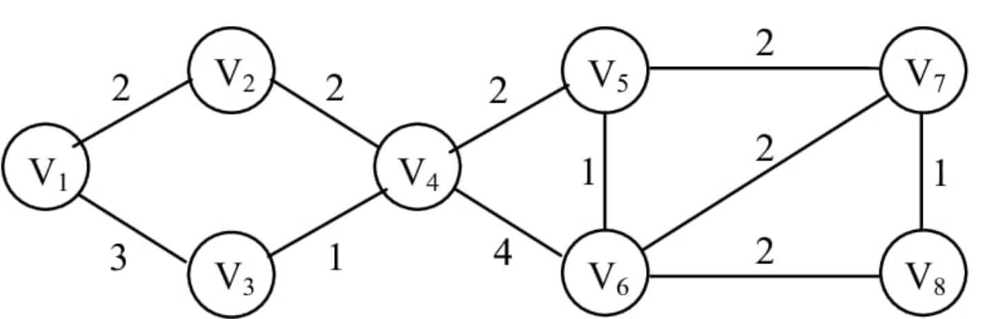
The Shortest Path
The shortest path is calculated based on which path gives the minimum cost. This path is chosen for delivery of food. This is to ensure the food is delivered within time and for an efficient service.
The Source and destination
V1 → source( Restaurant)
V7 → destination ( Delivery location 1)
V6 → destination ( Delivery location 2)

Slide 5

The delivery
To calculate all the paths from the restaurant (v1) to the delivery places (v6 and v7) in the given graph and find the shortest path, we can use Dijkstra's algorithm. Here are the paths and the shortest path:
Paths from v1 to v6:
v1 -> v2 -> v4 -> v6
v1 -> v3 -> v4 -> v6
Paths from v1 to v7:
v1 -> v2 -> v4 -> v6 -> v7
v1 -> v3 -> v4 -> v6 -> v7
Shortest path from v1 to v6: v1 -> v3 -> v4 -> v6 Shortest path from v1 to v7: v1 -> v3 -> v4 -> v6 -> v7
These paths represent the different routes from the restaurant to the delivery places, and the shortest path provides the most efficient route for food delivery.

Slide 6

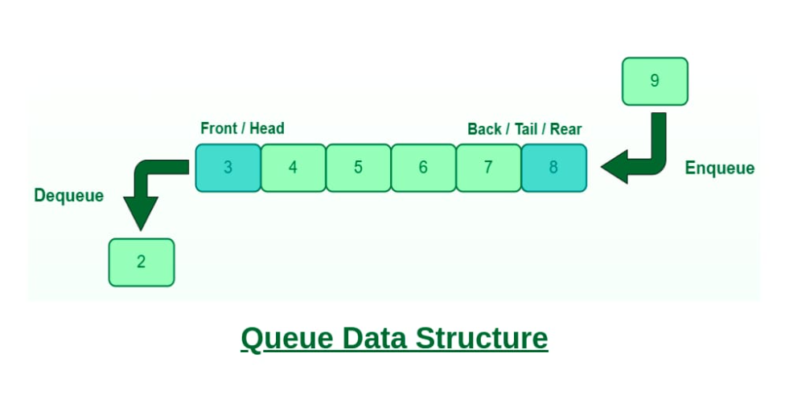
The Orders Queue

Slide 7
Define the Queue: Create a queue data structure that will hold the orders. The queue can be implemented using an array or a linked list.
Enqueue: When a new order comes in, add it to the end of the queue. This operation is called enqueue. The order will wait in the queue until it's ready to be processed.
Dequeue: To process an order, remove it from the front of the queue. This operation is called dequeue. The order at the front of the queue is the one that has been waiting the longest, so it is the next one to be processed.
Process the Order: Take the dequeued order and prepare the food accordingly. This step involves cooking, assembling, and packaging the food.
Repeat: Continue the process of dequeuing and processing orders until the queue becomes empty. If new orders arrive while the queue is being processed, enqueue them at the end of the queue.

Slide 8



Practical Applications
Package Delivery Routing
Ride-Sharing and Taxi Dispatch 🚚
Emergency Service Dispatch
The hybrid data structure can be applied to optimise package delivery routing systems. By representing the road network as a graph and using the queue to store delivery orders, the system can efficiently calculate the shortest paths between locations and dispatch delivery vehicles accordingly.
The hybrid data structure can be employed in emergency service systems, such as ambulance dispatch or fire department operations. This combination enables swift and effective emergency response, potentially saving lives and minimising damages.
By using the graph to model the road network and the queue to manage ride requests, the system can efficiently calculate optimal routes, match riders with available drivers, and minimise wait times.

Slide 9

Performance Analysis
Performance Comparison 📊
Using a separate queue for the delivery queue has comparable enqueue and dequeue time complexity but will lack efficient shortest path calculations.
Utilising a separate graph data structure allows efficient shortest path calculations but requires additional data structures for order and queue management.
1
2
3
Time Complexity ⏱️
Space Complexity
order_food() , view_order(), change_order(): O(1)
orders : O(N)
cancel_order(): O(N)
delivery_queue (queue): O(N)
deliver_orders(): O(N*(V+E))
‘graph’ dictionary: O(V + E)
Overall : O(N + V + E)

Slide 10

Discussion
1
Practicality and Effectiveness:
2
Limitations, Challenges, Future Improvements:
The hybrid data structure in the online food delivery system ensures efficient order management and optimised delivery paths.
While the implemented hybrid data structure demonstrates practicality and effectiveness, there are certain limitations and challenges to consider:
It handles large-scale datasets and processes operations seamlessly, including placing, modifying, and canceling orders.
Scalability
Dynamic Updates
By utilising a graph, it calculates shortest paths for optimal delivery routes, resulting in timely and accurate deliveries.
Optimal Path Calculation
Robustness and Fault Tolerance

Slide 11

Conclusion
The project designed and implemented a hybrid data structure for online food delivery, combining graph and queue structures for efficient order management and optimized delivery routes.
The hybrid data structure proved practical by utilizing graph algorithms for shortest path calculations and queue structures for timely order processing and delivery.
Performance analysis revealed favorable time and space complexity, with constant time for key operations and a time complexity of O(N * (V + E)) for path calculations.
Effective space utilization resulted in a space complexity of O(V + N + E), minimizing memory overhead.
Insights gained include the importance of careful data structure selection, trade-offs in scalability and dynamic updates, and opportunities for future enhancements in path optimization and system improvements.

Slide 12

References
Books:
[1] Thomas H. Cormen, Charles E. Leiserson, Ronald L. Rivest and Clifford Stein. , Introduction to Algorithms.
[2] Narsimha Karumanchi, Data Structures and Algorithms Made Easy .
Websites:
[1] N.E.Goller, “Hybrid Data Structures Defined by Indirection” [Online] Available URL: https://academic.oup.com/comjnl/article/28/1/44/468048
[2] “Big O Analysis and Hybrid Data Structures” [Online]. Available: URL: https://docs.onenetwork.com/NeoHelp/devnet/big-o-analysisand-hybrid-data-structures-79141067.html
[3] Dario Radecic, “Data Structures and Algorithms With Python” IEEE Explore. [Online] Available URL: https://towardsdatascience.com/datastructures-and-algorithms-with-python-learn-stacks-queues-and-deques-in-10- minutes-e7c6a2a1c5d5
[4] JavaTpoint, “Data Structures and Algorithms in Python” . [Online] Available URL: https://www.javatpoint.com/data-structures-and-algorithms-inpython-set-1

